Slide 1
The Expeditioners
Group 11
Aditya Padhiar
Vatsal Gujarati
Nikhil Mehta
Sudhanshu Mishra

Slide 2
What user problem are we trying to solve?
Most of the trekking websites don’t allow specific filters and bookmark feature. We tried to fix that in our prototype.
Who are the users?
Users are mix bag including experienced trekkers, ones who’ve never been to treks, and users who’ve like been to a few treks.

Slide 3
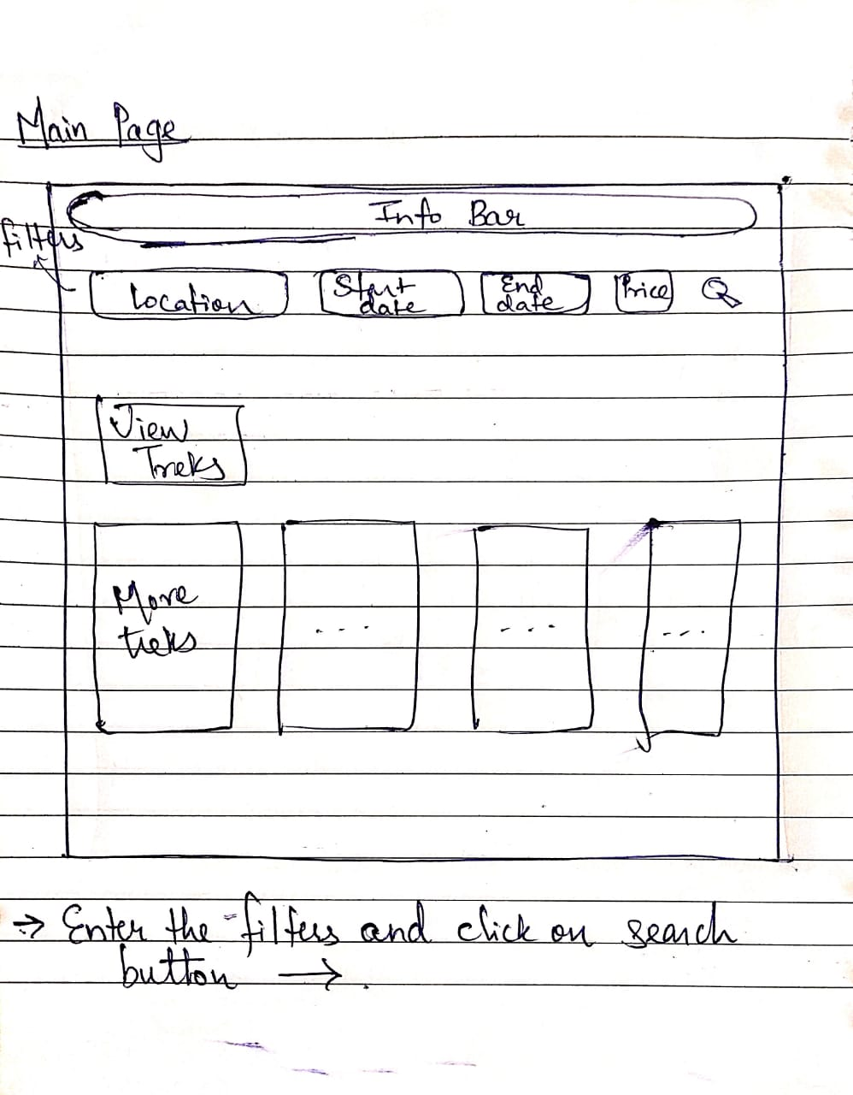
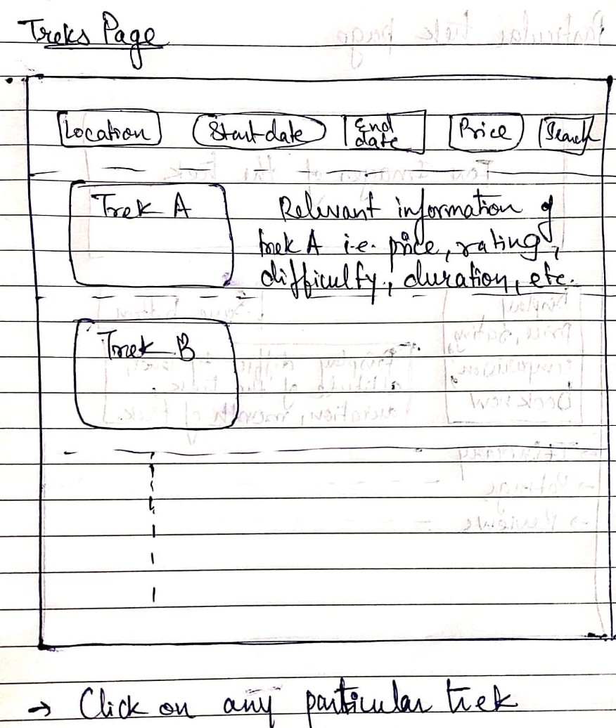
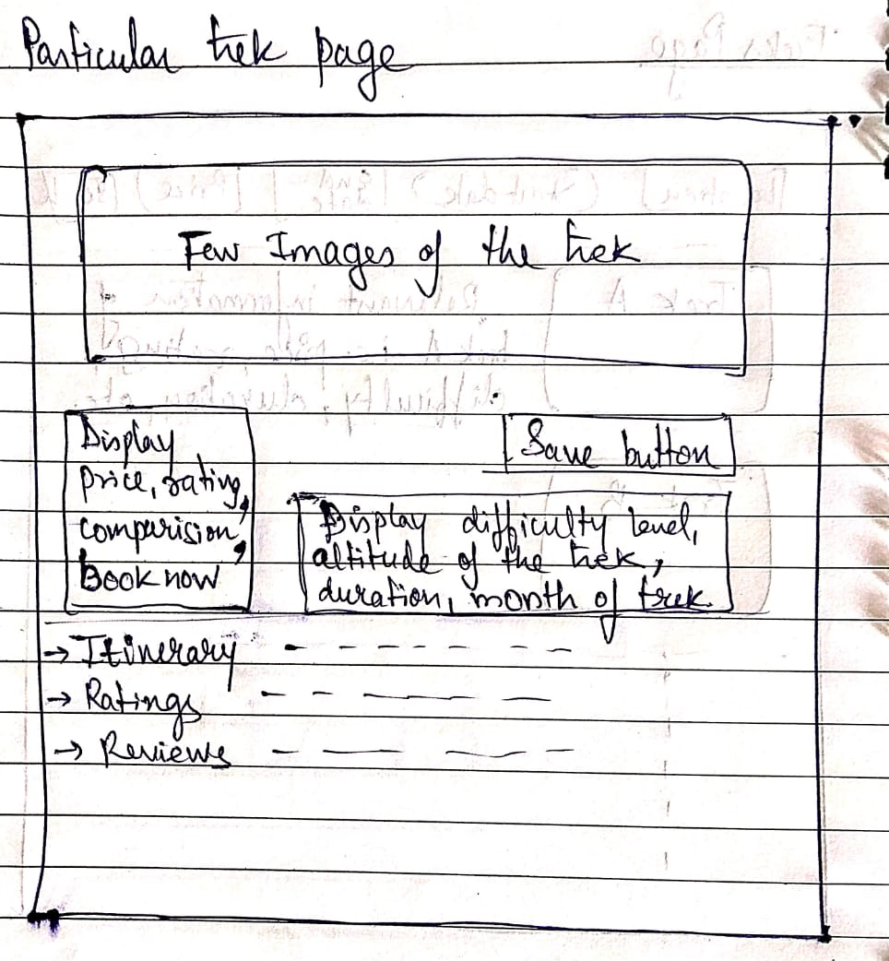
Paper Prototype

Slide 4
Now let’s have a look at some of the Mockups

Slide 5
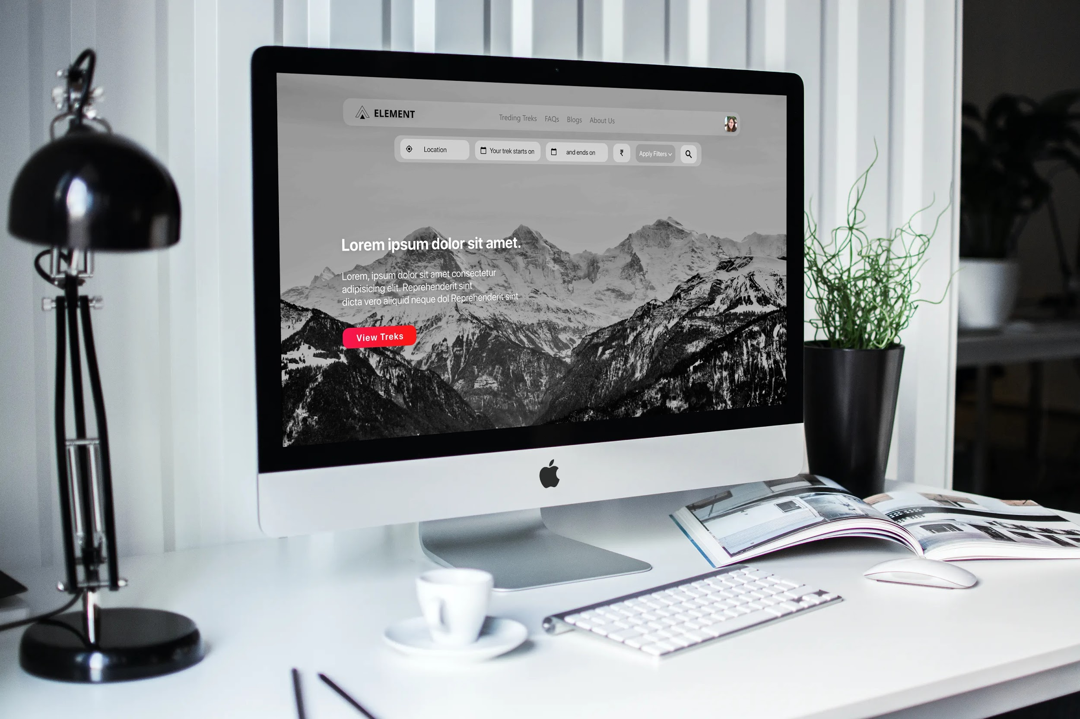

Slide 6
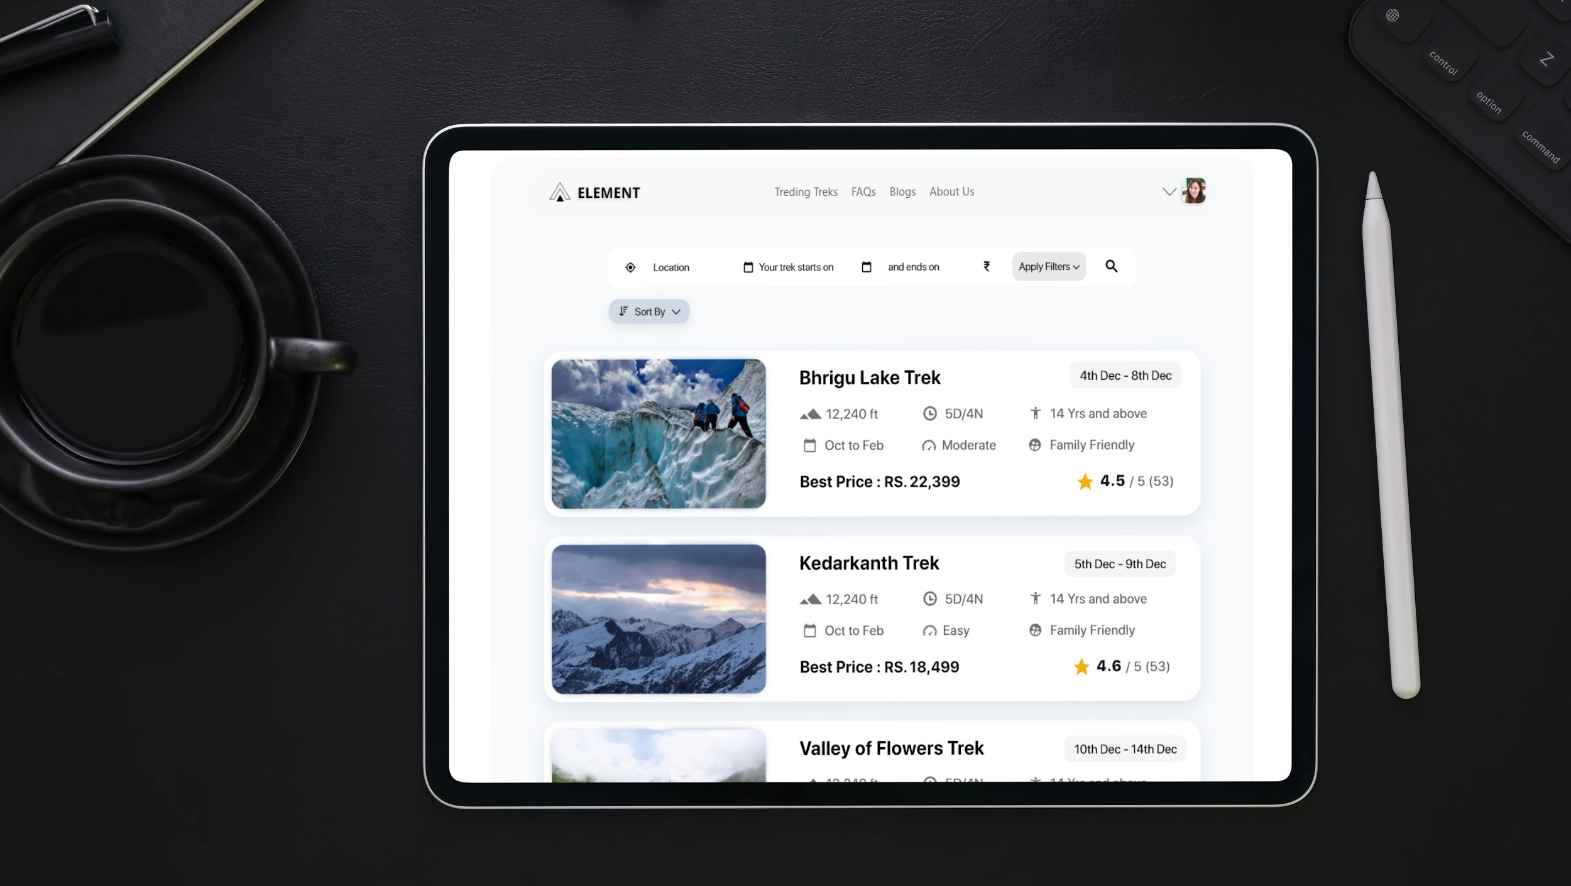

Slide 7
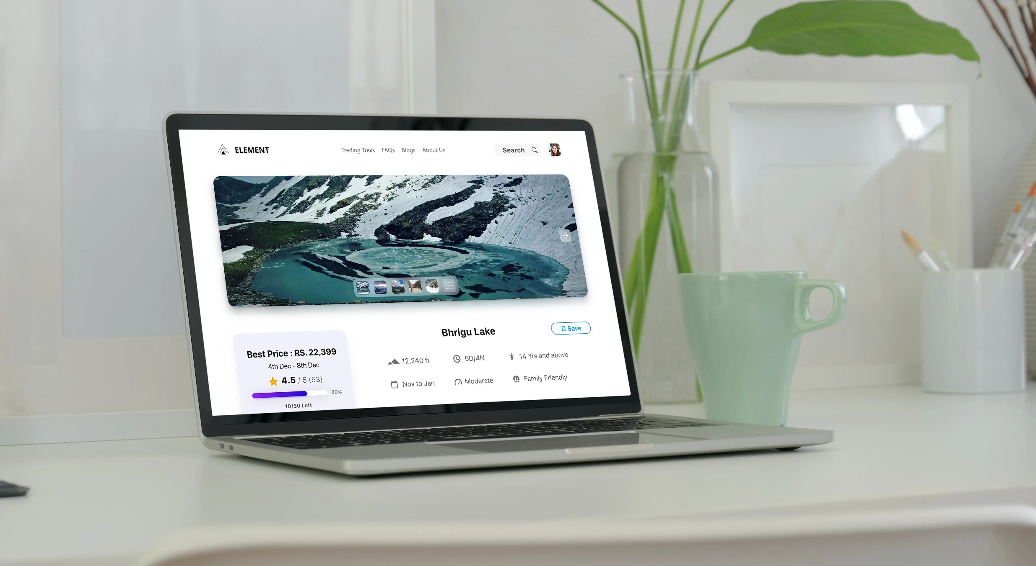

Slide 8
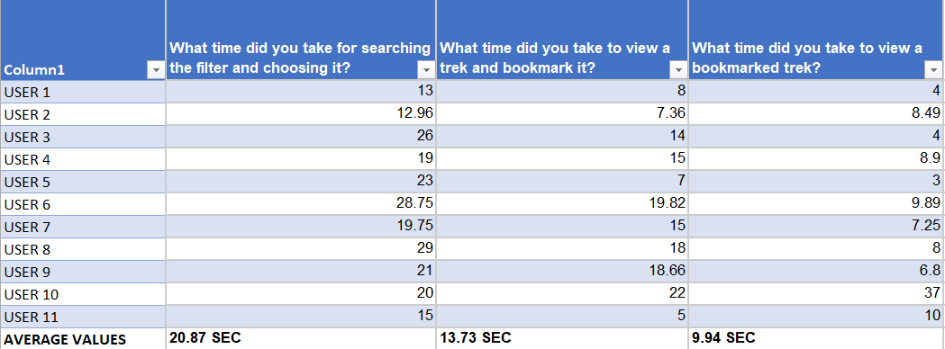
Evaluation
Task Completion and Task analysis :-

Slide 9
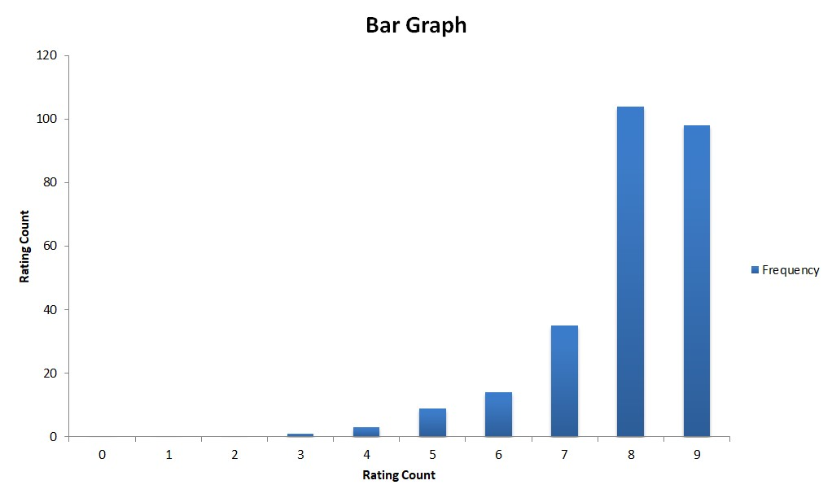
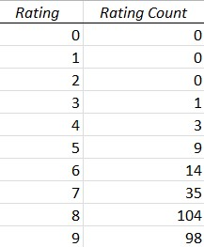
QUIS (Questionnaire for User Interaction and Satisfaction)

